Slide 1
AI STUDY BUDDY
Team Project - MSc Computer Science
Anika Mayesha – D24125187
Lorenzo Palleschi – D24126922
Rumaysa Babulkhair – D24125711
Yurii Sykal – C23512523

Slide 2

BRIEF WEEKLY OVERVIEW
Logo
Retrospectives
Requirement Specification
Login / Registrations Page
Figma Design Overview
Figma Coded Version

Slide 3



LOGO PROTOTYPE
Feedback received about initial design
Adapted centre to be more fitting for study related service
Bigger companies tend to simplify logos

Slide 4
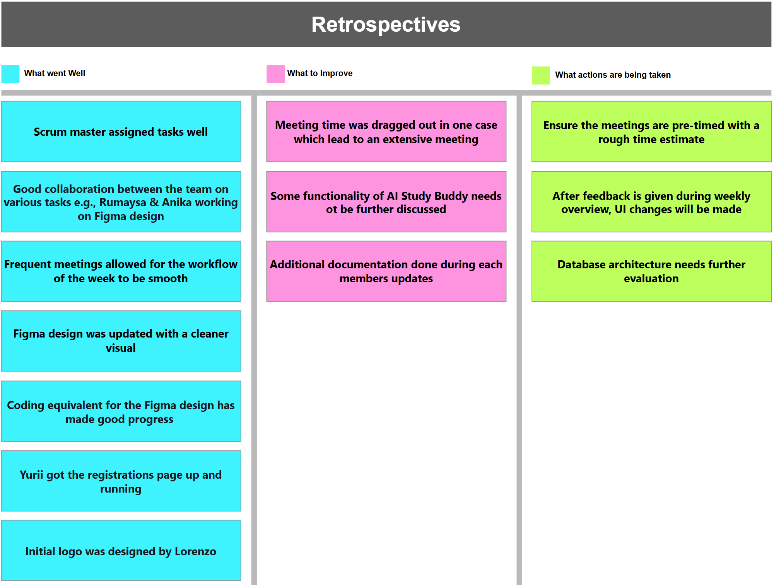

Slide 5

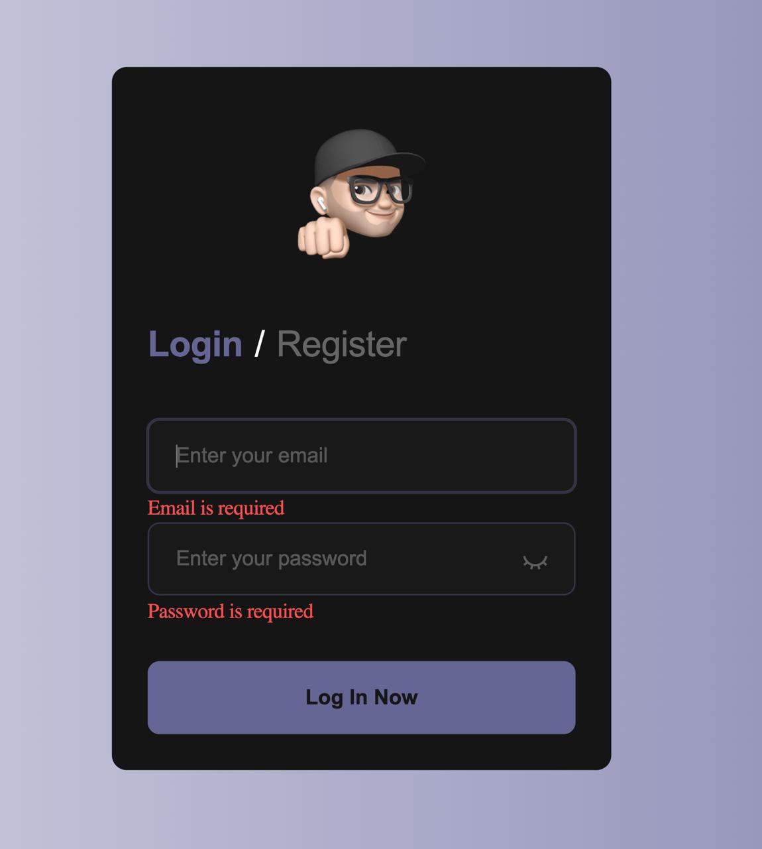
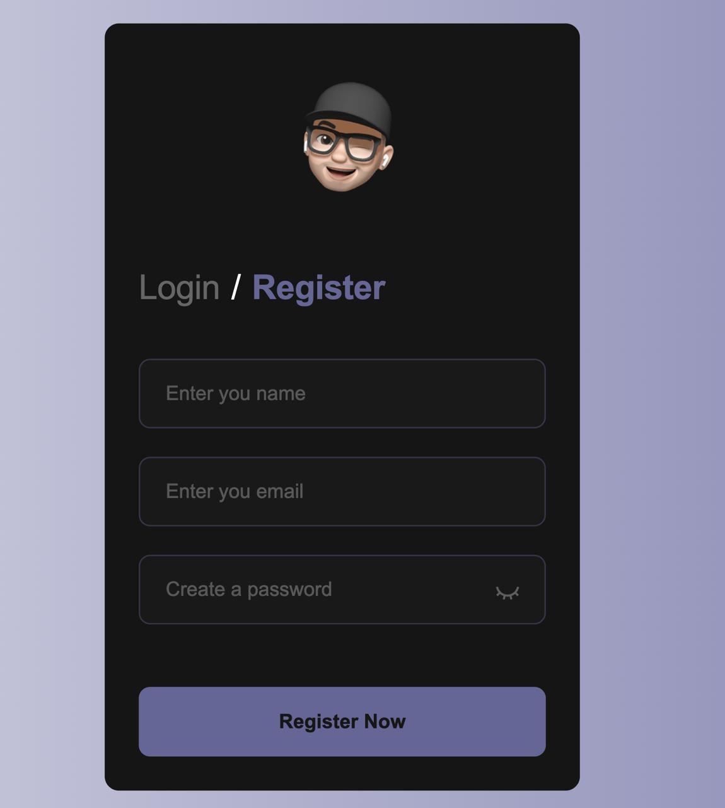
LOGIN/REGISTRATION PAGE
• Initial version (1.0)

Slide 6
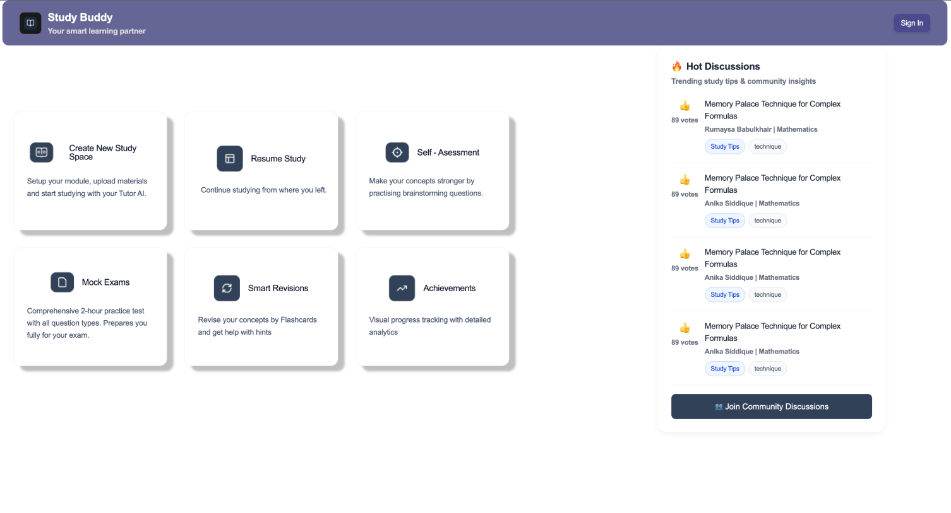
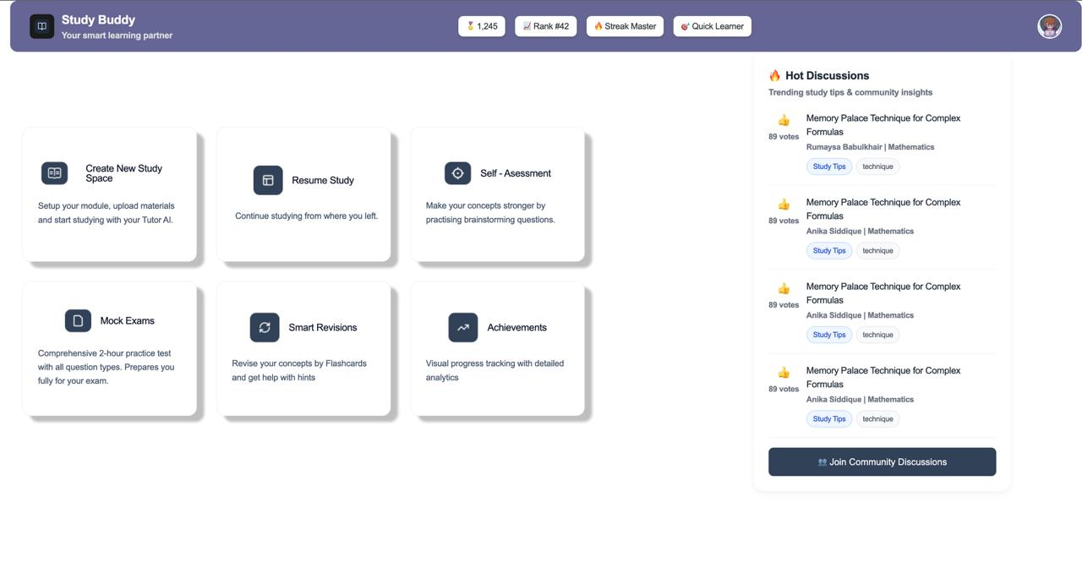
FIGMA TURNED INTO LIVE CODE
Dashboard has been structurally built
Other pages in progress

Slide 7
FIGMA TURNED INTO LIVE CODE
Dashboard has been structurally built
Other pages in progress

Slide 8
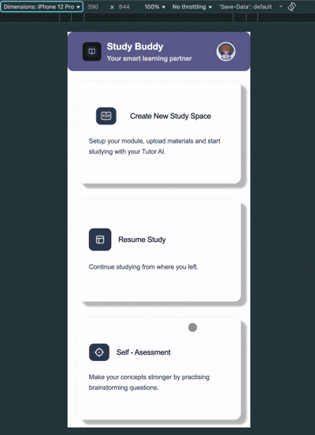
MOBILE

Slide 9
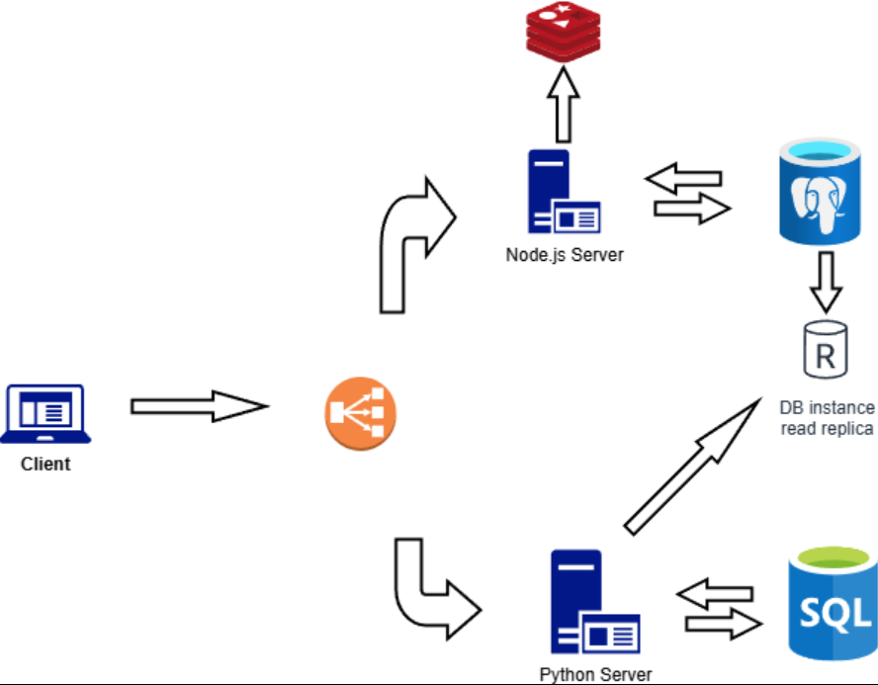
REQUIREMENT SPECIFICATION
Brief details tba

Slide 10
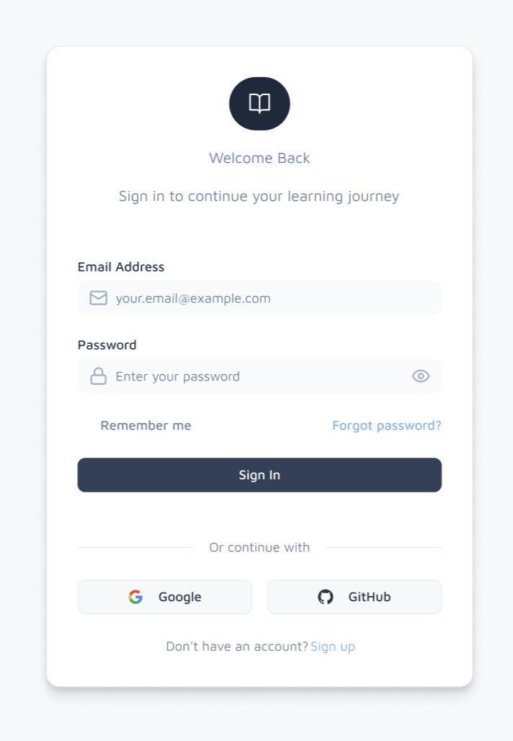
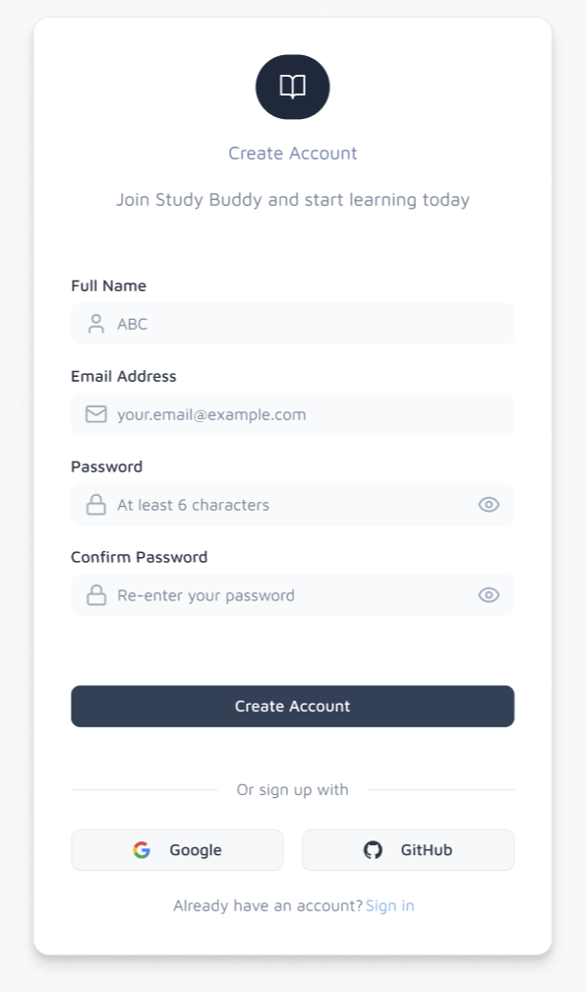
FIGMA DESIGN (Login/Register)
Sign In
Sign Up

Slide 11
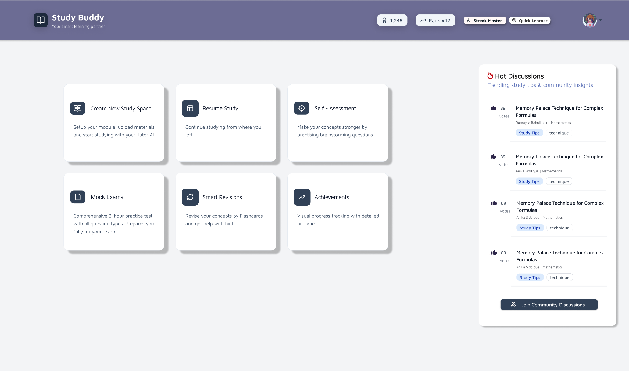
FIGMA DESIGN (DASHBOARD)
Figma design is now updated with a sleeker interface
More neutral colour scheme

Slide 12
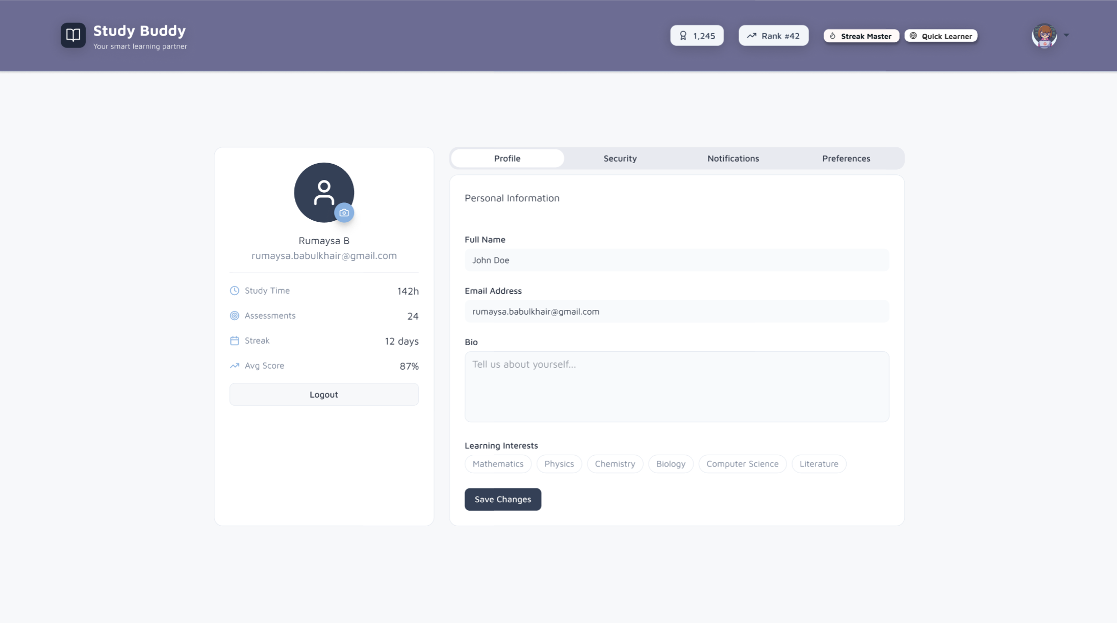
FIGMA DESIGN (Account)

Slide 13
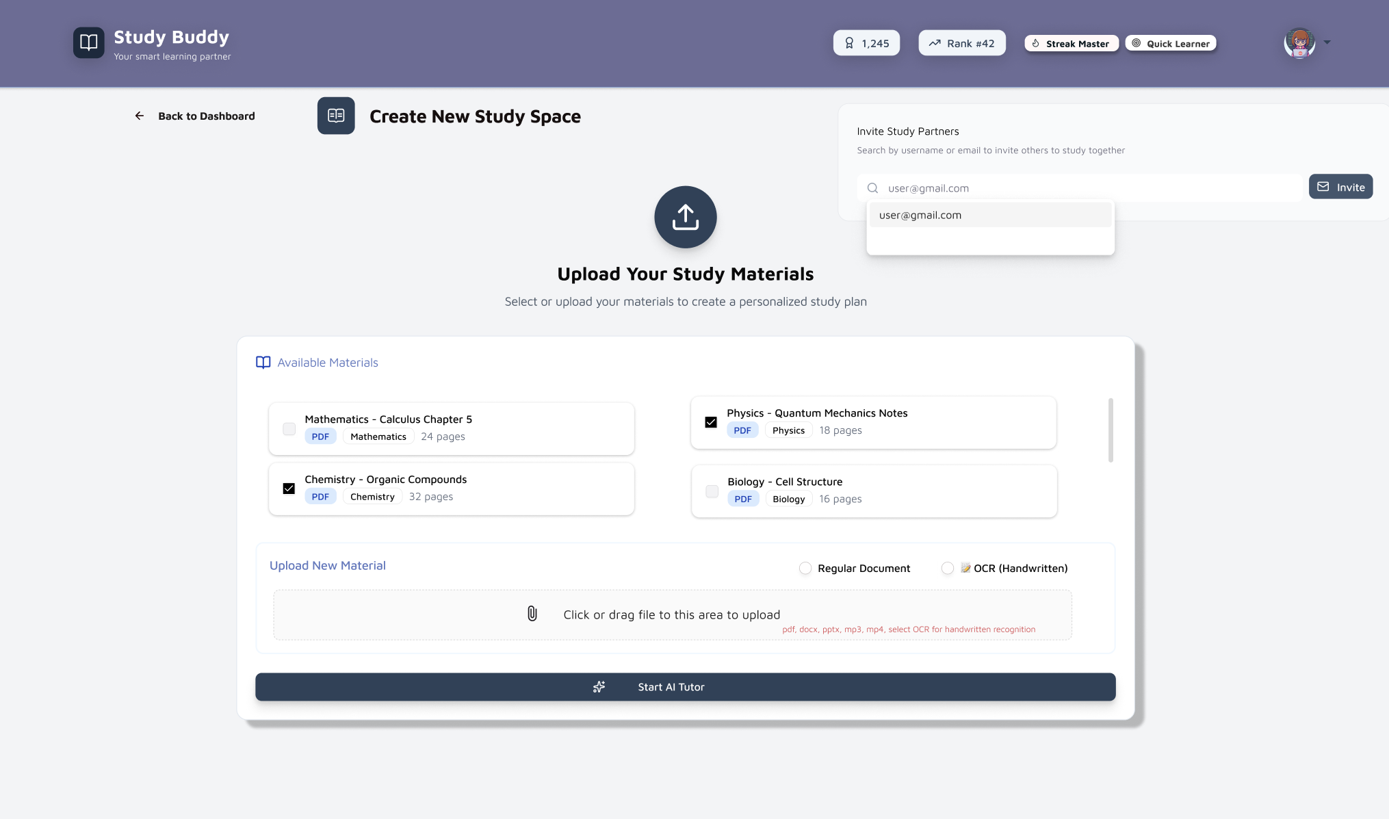
FIGMA DESIGN (STUDY SPACE)

Slide 14
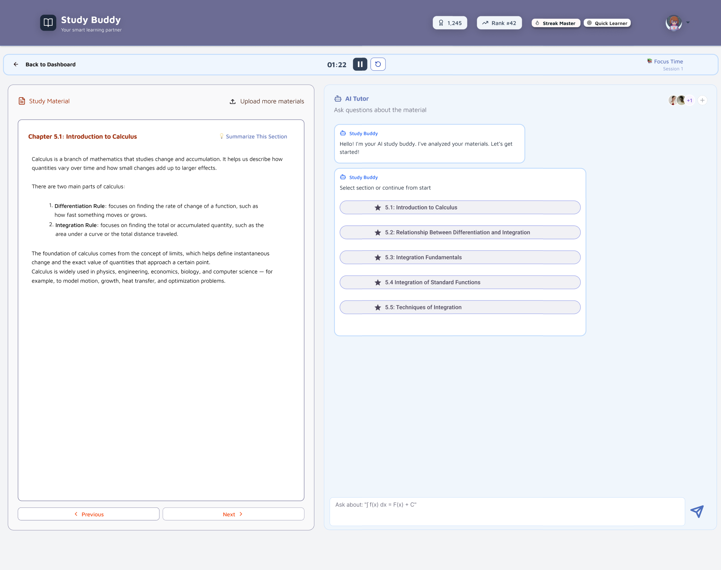
FIGMA DESIGN (AI TUTOR)

Slide 15
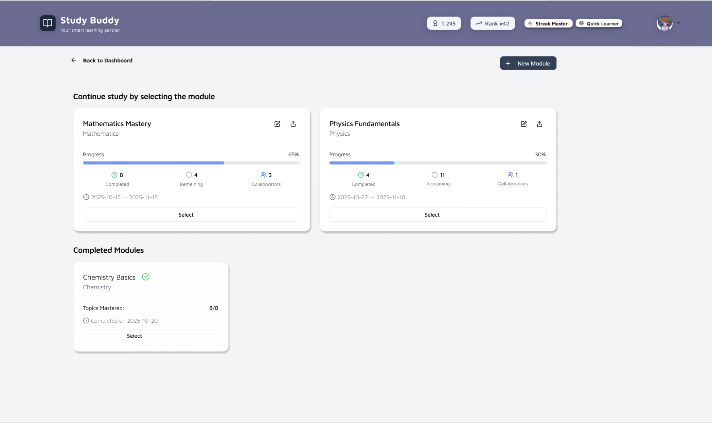
FIGMA DESIGN (Resume Study)

Slide 16
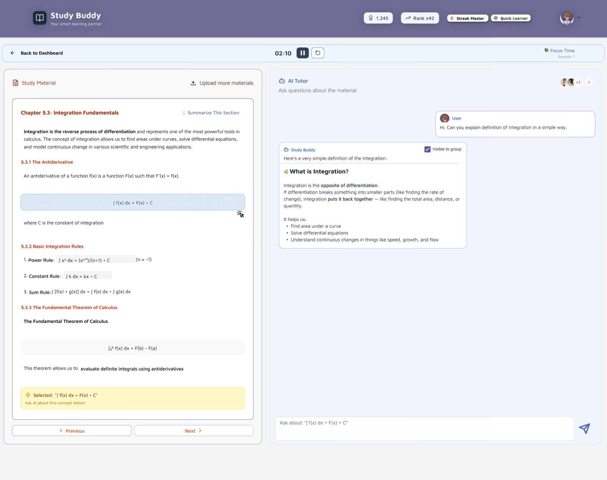
FIGMA DESIGN (AI TUTOR #2)

Slide 17
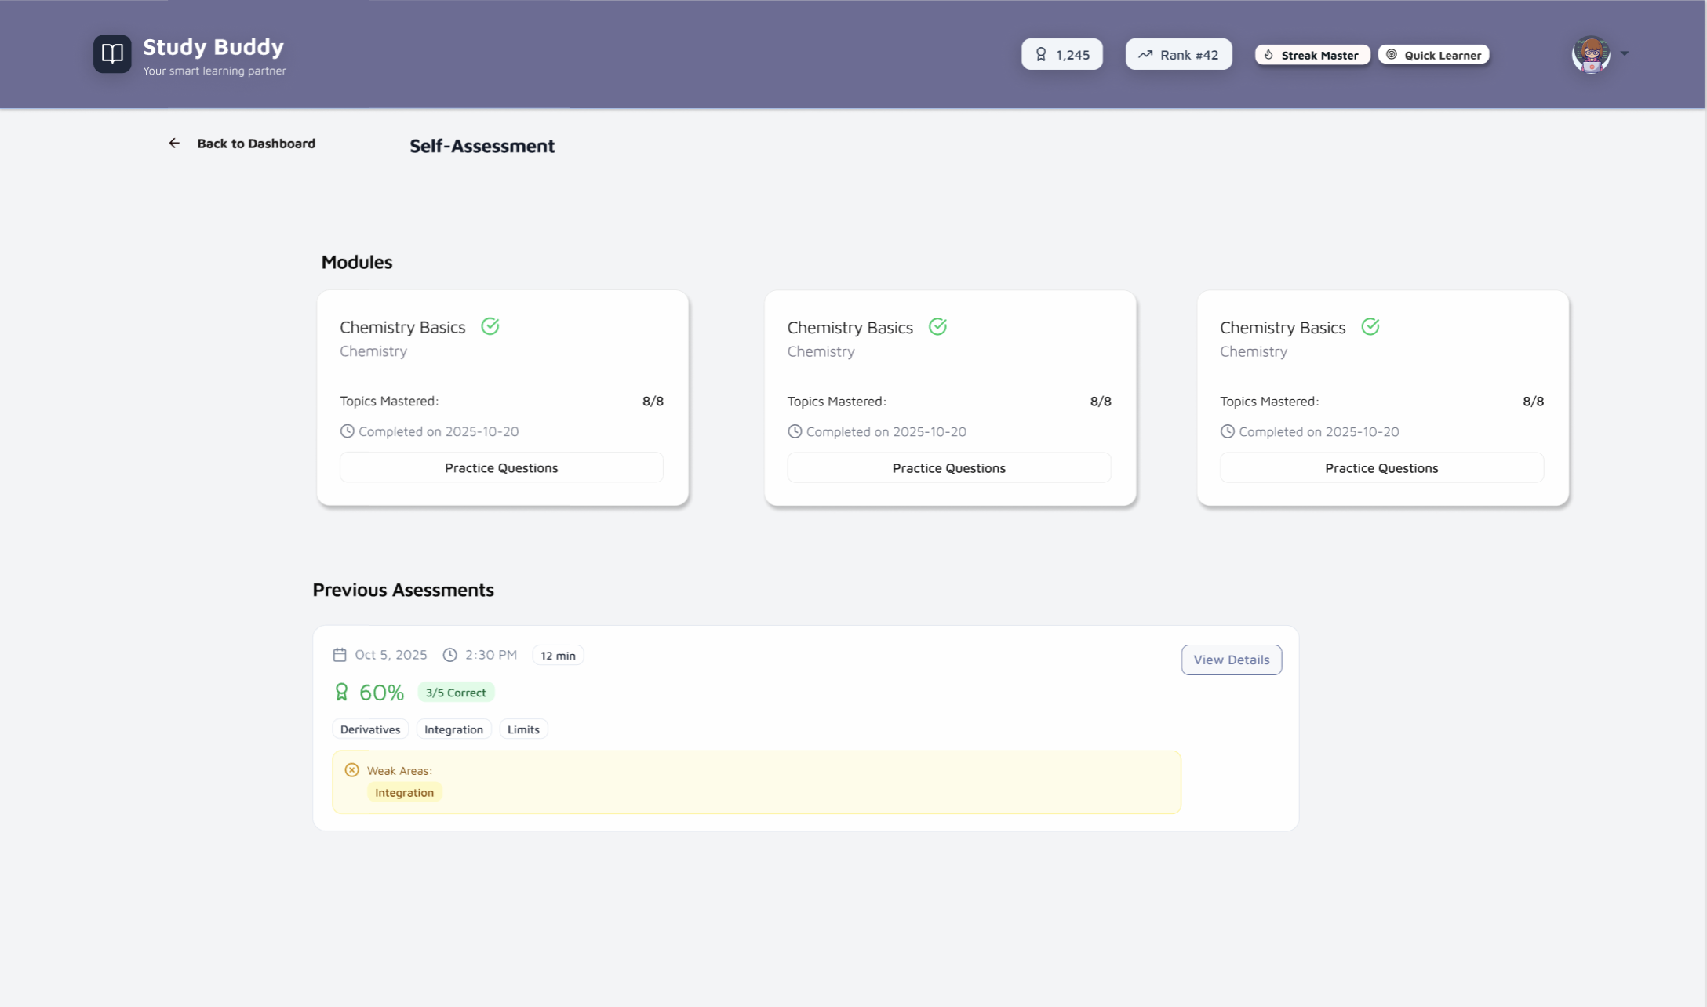
FIGMA DESIGN (Self-assessment)

Slide 18
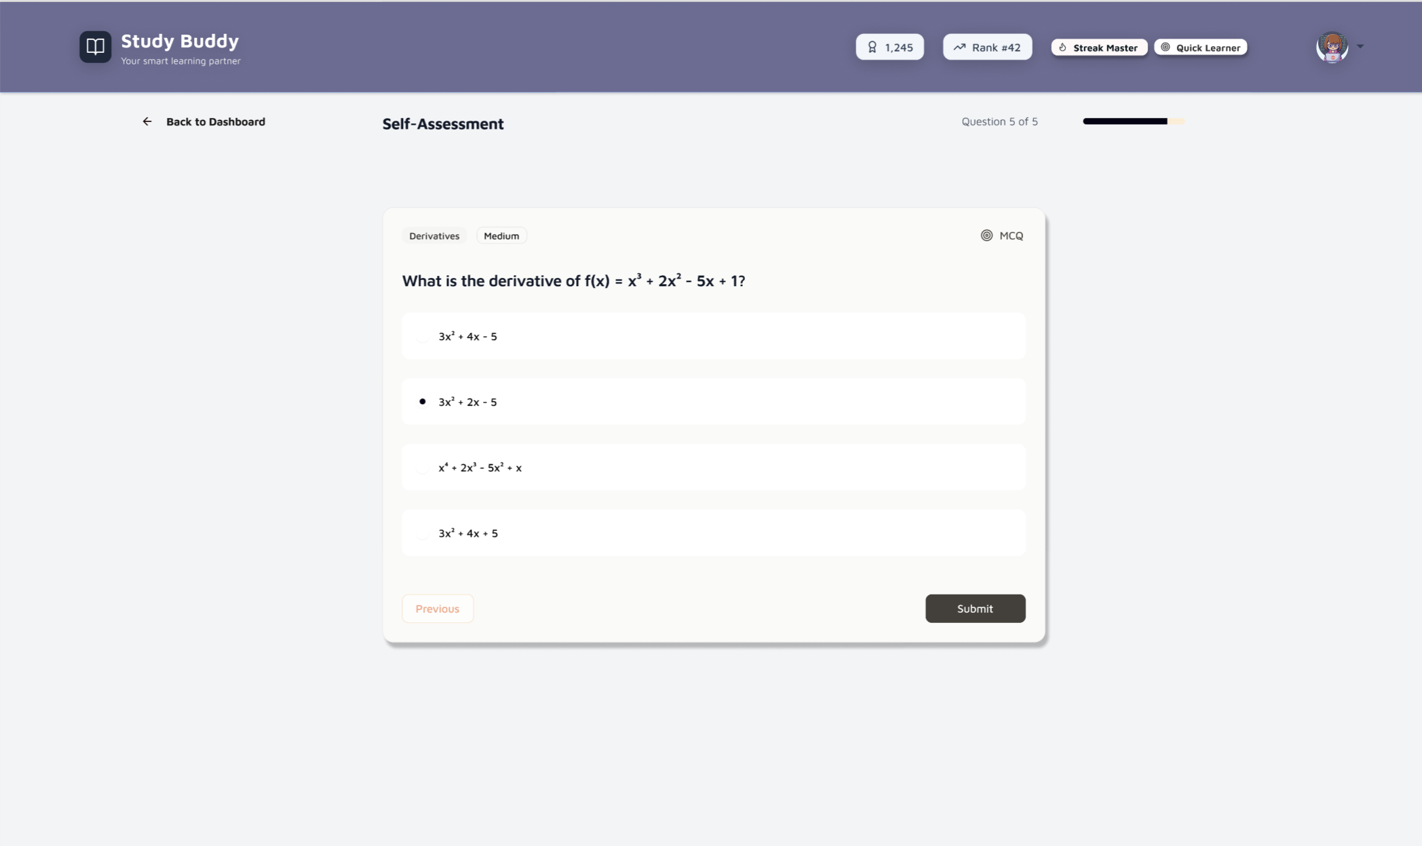
FIGMA DESIGN (Self-assessment)

Slide 19
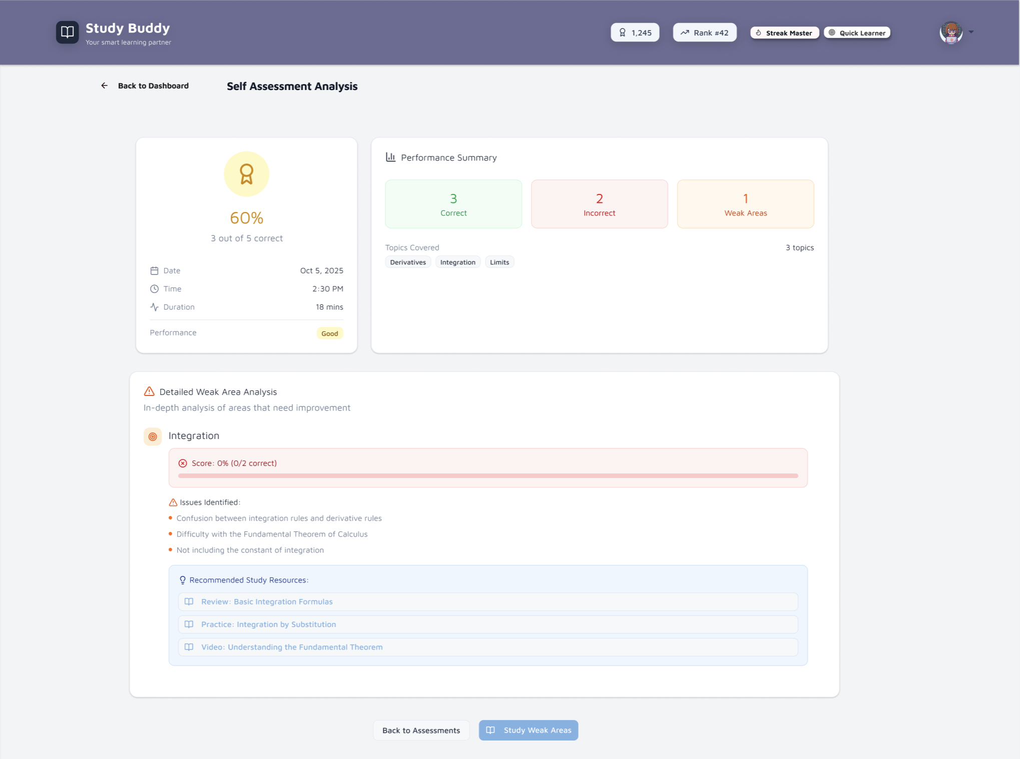
FIGMA DESIGN (Self-assessment)

Slide 20
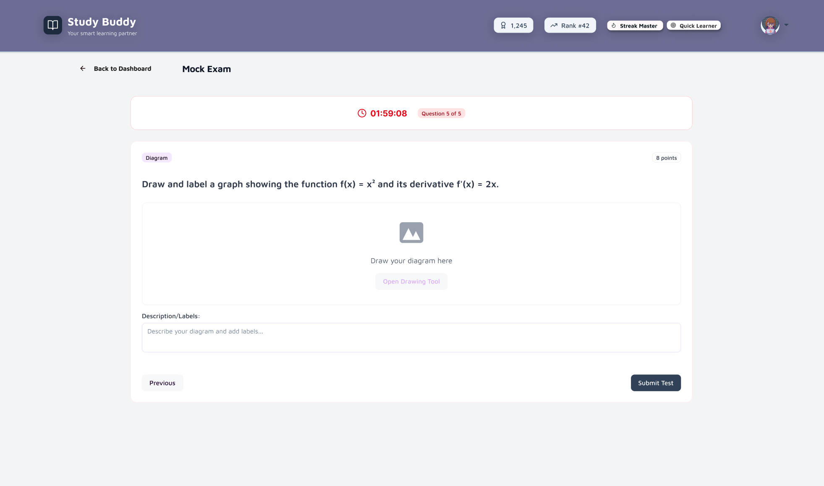
FIGMA DESIGN (MOCK EXAM)

Slide 21
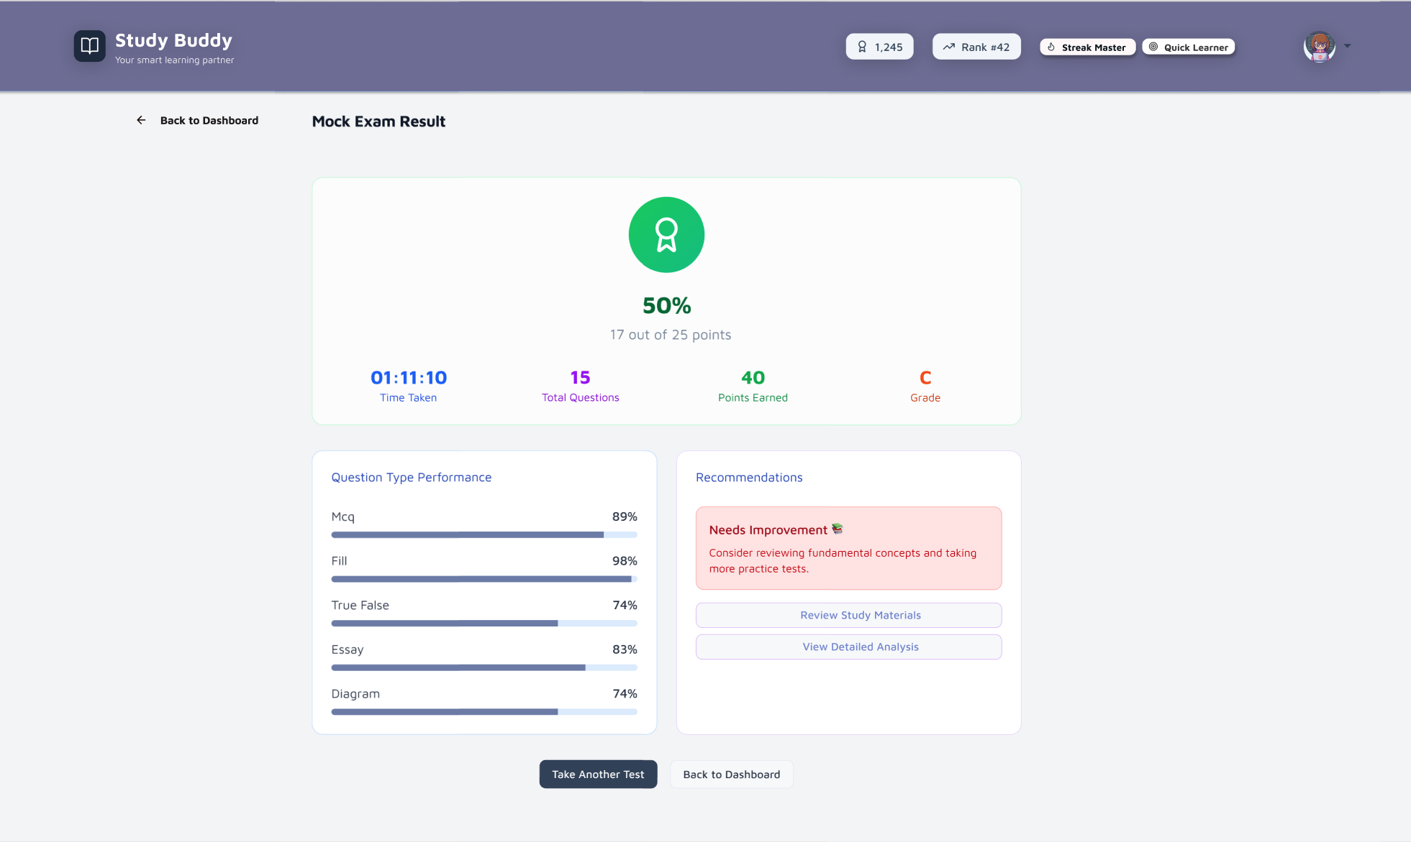
FIGMA DESIGN (MOCK RESULTS)

Slide 22
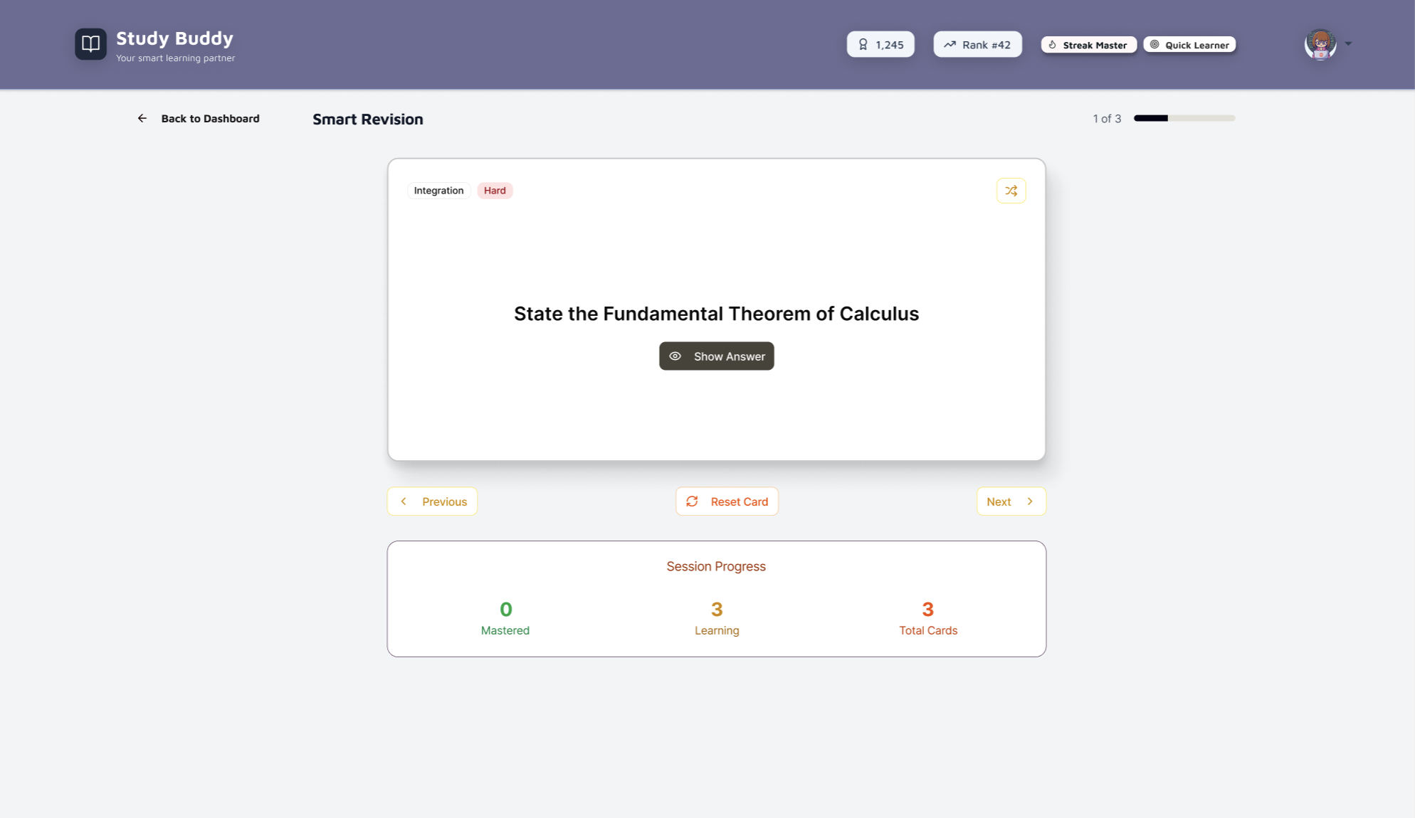
FIGMA DESIGN (Revisions)

Slide 23
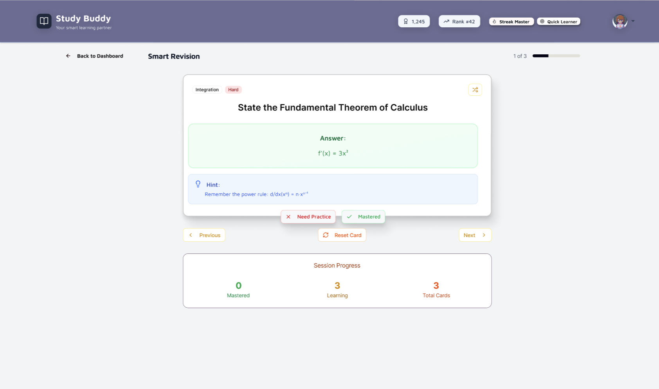
FIGMA DESIGN (Revisions)

Slide 24
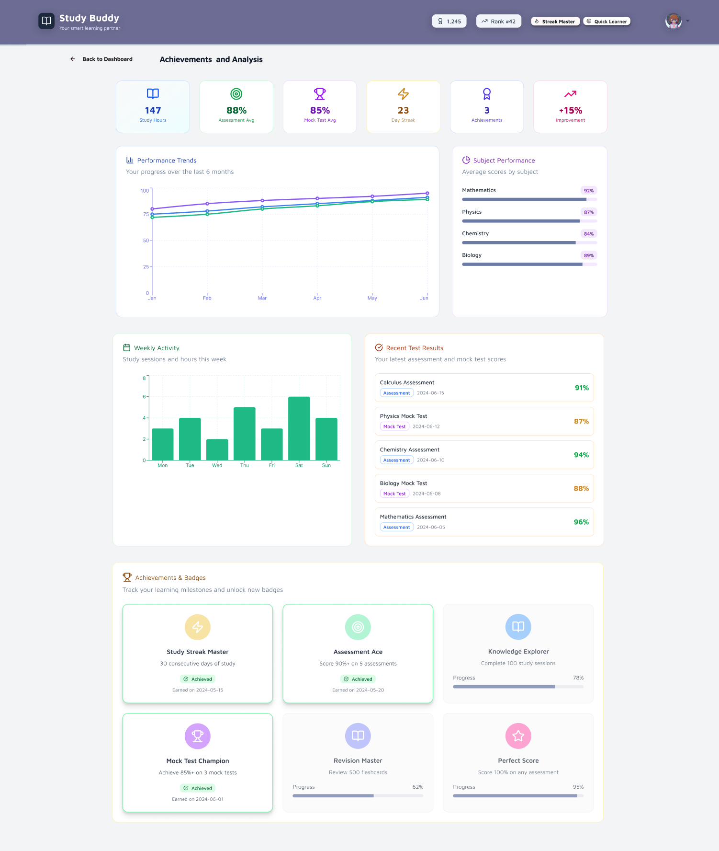
FIGMA DESIGN (ACHIEVEMENTS)

Slide 25
THANK YOU
Any Questions?

